Slide 1

IT Infrastructure Management Chapter 5: ITIL MANAGEMENT PRACTICES TY B.Sc. (IT)
Semester VI
Poornima .N
Assistant Professor, Department of IT/CS
1

Slide 2

1 Topics:
General Management Practices:
Service Management Practices:
Technical Management Practices:

Slide 3

2 General management
General management practices have been adopted and adapted for service management from general
business management domains.

Slide 4
2 Service management
Service management practices have been developed in service management and ITSM industries.

Slide 5
2 Technical management
Technical management practices have been adapted from technology management domains for service
management purposes by expanding or shifting their focus from technology solutions to IT services.

Slide 6
1. Architecture management

Slide 7
2 1. Architecture management:
Architecture Management ensures all parts of the organization fit and work together properly (processes, people, technology). 👉 Like a blueprint for services and systems.

Slide 8
2 1. Purpose:
🎯 To help the organization achieve its goals now and in the future, in a structured and Agile way.
✔ Reduce complexity ✔ Manage change easily ✔ Avoid risk and confusion ✔ Improve automation & efficiency

Slide 9
2 1. Why do we need it?
Without architecture management → organization becomes:
⚠️ Confusing systems ⚠️ Different processes everywhere ⚠️ Many outdated technologies ⚠️ High risk when changes happen
So architecture gives visibility + coordination.

Slide 10
2 1. Five Architecture Domains
Type | Simple Student Example
Business | College goals, courses, departments
Service | How admission portal, LMS, ERP connect
Information | Student records, results, attendance data
Technology | Wi-Fi, servers, software, lab systems
Environmental | Rules → NAAC, University norms, legal policies

Slide 11
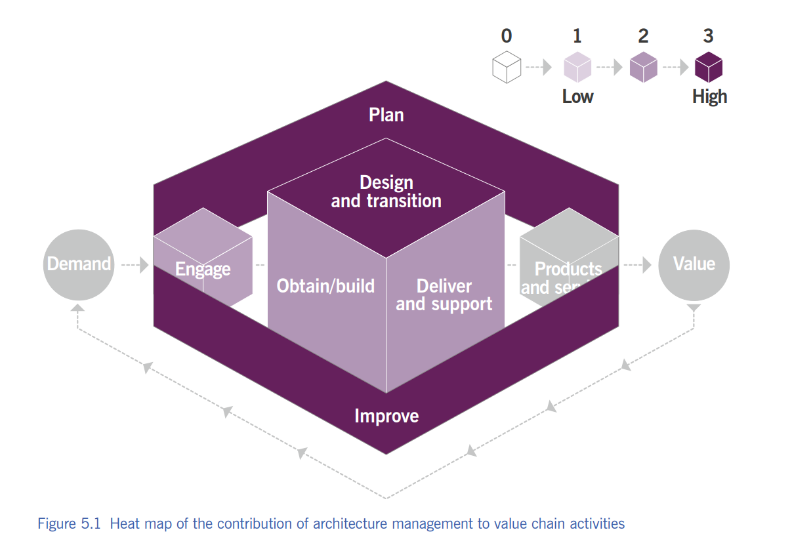

Slide 12
2 1. Real College Example
When college introduces new online exam system:
✔ Business → Who needs what? ✔ Service → How modules fit together? ✔ Information → Secure student data? ✔ Technology → Wi-Fi, servers ready? ✔ Environmental → University rules followed?
That is Architecture Management in action!

Slide 13
2 1. ⏳ Activity: “Build Your Ideal College”
Design a PERFECT college (as architects). What will you plan in each BSITE domain?
✔ Business → Who needs what? ✔ Service → How modules fit together? ✔ Information → Secure student data? ✔ Technology → Wi-Fi, servers ready? ✔ Environmental → University rules followed?

Slide 14
2. Continual Improvement

Slide 15

3 2. Continual Improvement
Continual Improvement means regularly improving services, processes, and products so they remain aligned with changing business needs.

Slide 16
3 2. Why is it Important?
💡 Because:
Customer expectations keep changing
Technology keeps changing
Competitors keep improving
➡️ So we must also keep improving — step by step.

Slide 17
3 2. Real-Life Example
Example: Your College 🎓
Before | After Improvement
Slow admission process | Online form introduced
Students confused about timetable | Timetable on WhatsApp + notice board
Delayed assignments | Google Classroom reminders
👉 This is Continual Improvement in action.

Slide 18
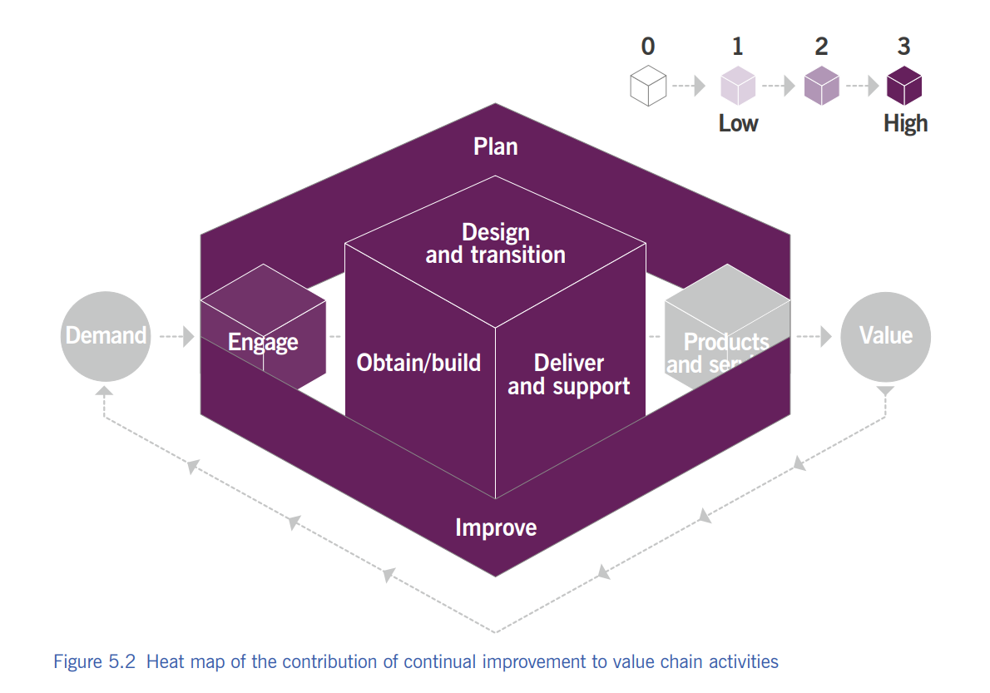

Slide 19
3 2. Where Improvement Ideas Come From
SWOT analysis
Audits or reviews
Customer feedback
Market changes
Problem management / incident data
Staff suggestions
DevOps / Agile feedback cycles

Slide 20
3 2. Who is Responsible?
🔥 EVERYONE. Not only management.
Students can suggest improvements
Teachers improve teaching style
Management improves system
Vendors/suppliers must also improve service
Add line to make it memorable:

Slide 21
3 2. Continual Improvement Register (CIR)
A record where improvement ideas are stored, reviewed, and tracked until completed.
Idea | Priority | Status
Online fees option | High | Completed
More fans in classrooms | Medium | In progress
College app | Low | Planned

Slide 22
3 2. Activity Name: “Fix Your Classroom 🚧”
Look around the classroom or college and find 2 things that can be improved.
They write them on paper or raise hand.
You choose 5 best ideas and convert them into a CIR table on the board.

Slide 23

4 3: Information Security Management (ISM)
It protects the organization's information from unauthorized access, misuse, loss, or damage.

Slide 24

4 3: Why is it Needed?
🤔 If someone steals:
Your exam question papers
Your bank OTP
Your login password
Your Aadhaar number
➡️ BOOM 💥 you're in trouble.
So we protect information just like we protect our money or phones.

Slide 25
4 3: The CIA Triad
⭐ This is the HEART ❤️ of Information Security.
🔑 Element | Meaning | Example
C – Confidentiality | Only authorized people can access info | Password on phone
I – Integrity | Information must remain accurate & unchanged | Marksheet without tampering
A – Availability | Information should be available when needed | Online banking server running

Slide 26
4 3: Extra Security Concepts
✔ Authentication: Proving you are who you claim to be 👉 Example: OTP login
✔ Non-repudiation: You can’t deny your actions later 👉 Example: Digital signature, email trail

Slide 27
4 3: Balance Needed
📌 Information security must balance:
🔹 Security (protect) 🔹 Innovation (work freely)
Quote for the slide:
“Too much security = no work. No security = disaster.”

Slide 28
4 3: Methods Used
Security is implemented using:
🔹 Policies 🔹 Processes 🔹 Behaviours & culture 🔹 Controls (firewalls, passwords, audits) 🔹 Risk management 🔍
🧠 Security isn’t only technology — it's about PEOPLE + PROCESS + TECH.

Slide 29
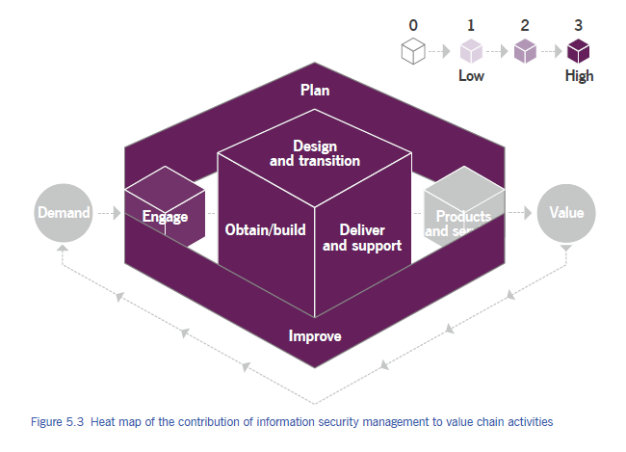

Slide 30
4 3: Who Is Responsible?
👉 Everyone.
But usually managed by:
Chief Information Security Officer (CISO)
Information Security Team
⚠ Biggest weakness in security is NOT technology — it's careless people.
Example line:
Your password shouldn't be: Admin, pooja123, ilovemyself, qwerty……etc

Slide 31
4 3: Activity: “Spot the Risk” Game
Scenario | Secure?
Using same password everywhere
Locking laptop when leaving desk
Sharing OTP with friend
Enabling 2-factor authentication
Clicking unknown link saying "You won 5 crore"

Slide 32
4. Knowledge Management

Slide 33
4 4. What Is Knowledge Management?
Knowledge Management makes sure the right information reaches the right people at the right time so they can work smarter and faster.

Slide 34
4 4. Information vs Knowledge
Information 📄 | Knowledge 🧠
Raw facts | Information + experience + context
Example: 300-page manual | A simple solution guide for service desk
Not always useful | Useful when needed

Slide 35
4 4. Types of Knowledge
Type | Meaning | Example
Explicit | Written, documented | Manuals, FAQs, SOPs
Tacit | In people's minds | Experience, skills, shortcuts

Slide 36
4 4. What KM Ensures
Knowledge Management ensures:
✔ Right information ✔ Correct format ✔ Right time ✔ To the right person ✔ With proper access level
Example: Technician needs a solution fast — NOT a 20-page theory.

Slide 37
4 4. 🎭 Class Activity: “Ask the Expert” Game
Steps:
1️⃣ Pick 3 students. 2️⃣ They act as “Knowledge Desk”. 3️⃣ Others ask them a simple tech or college-related question. 4️⃣ If the student knows → 👍 5️⃣ If not → They must ask another student (KM = sharing knowledge).

Slide 38
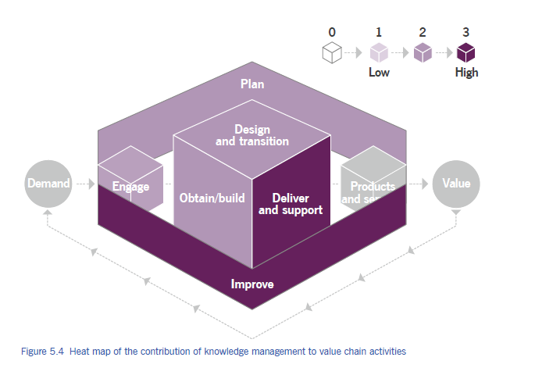

Slide 39
5. Measurement and reporting

Slide 40
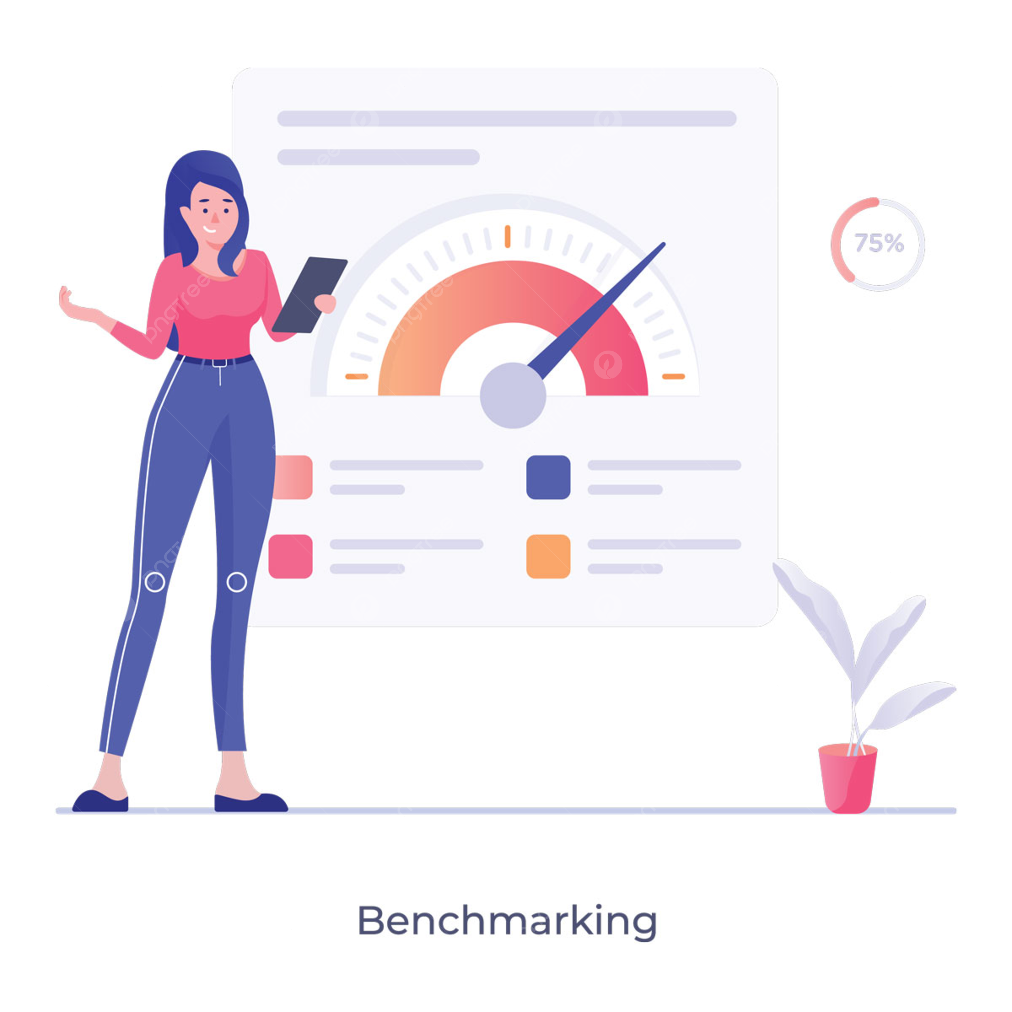
4 5. What is Measurement & Reporting
Measurement & Reporting helps organizations make better decisions by reducing uncertainty through the correct collection and analysis of data.

Slide 41
4 5. What Do We Measure?
Managed objects include:
Products & services
Practices & processes
Value chain activities
Teams & individuals
Suppliers & partners
Entire organization
➡ All these are connected, so their metrics are connected too.

Slide 42
4 5. Why Measurement Matters?
🎯 Organizational goals could be about:
Profit
Growth
Customer satisfaction
Public service
MeasuremCompetitive advantage
ent links big goals → CSFs → KPIs.

Slide 43
4 5. CSF vs KPI
Term | Meaning | Example
CSF (Critical Success Factor) | A must-have condition to succeed | “Resolve 80% incidents on first call”
KPI (Key Performance Indicator) | A metric used to judge success | “First call resolution %”

Slide 44
4 5. Why Measurement Matters?
KPIs can motivate, but they can also spoil behaviour if used wrong.
📌 Example of Wrong KPI:
Service desk staff asked to keep calls short → They may rush calls → poor resolution → unhappy customers
✔ Better approach: Team KPIs, not individual-only KPIs 😊 Encourages collaboration 😊 Less pressure 😊 Aligns with organizational value

Slide 45
4 5. Good Measurement = Good Reporting
Metrics → Reports → Decisions
Reports should answer two questions:
1️⃣ How far are we from the target? 2️⃣ What bottlenecks are stopping us?
🖼️ Idea: dashboard screenshot style

Slide 46
4 5. What a Good Report Looks Like
✔ Clear ✔ Visual ✔ Relevant ✔ Action-oriented ✔ Up-to-date ✔ Easy to understand
Examples:
Traffic light signals (red–yellow–green)
Trend charts
Pie charts
Progress bars

Slide 47
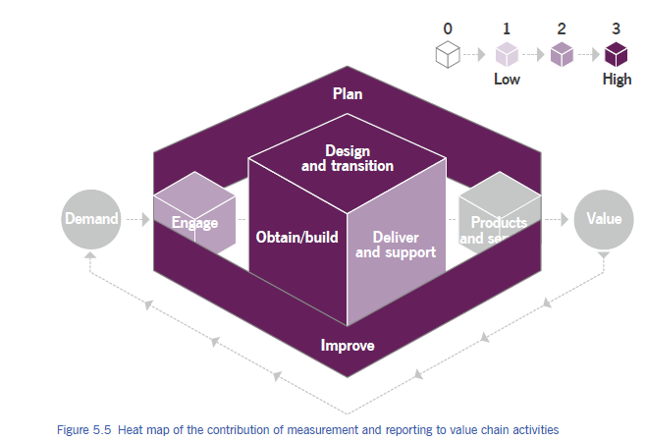

Slide 48
4 5. 🎮 Class Activity “Dashboard Detective”
What metric needs improvement?
What is performing well?

Slide 49
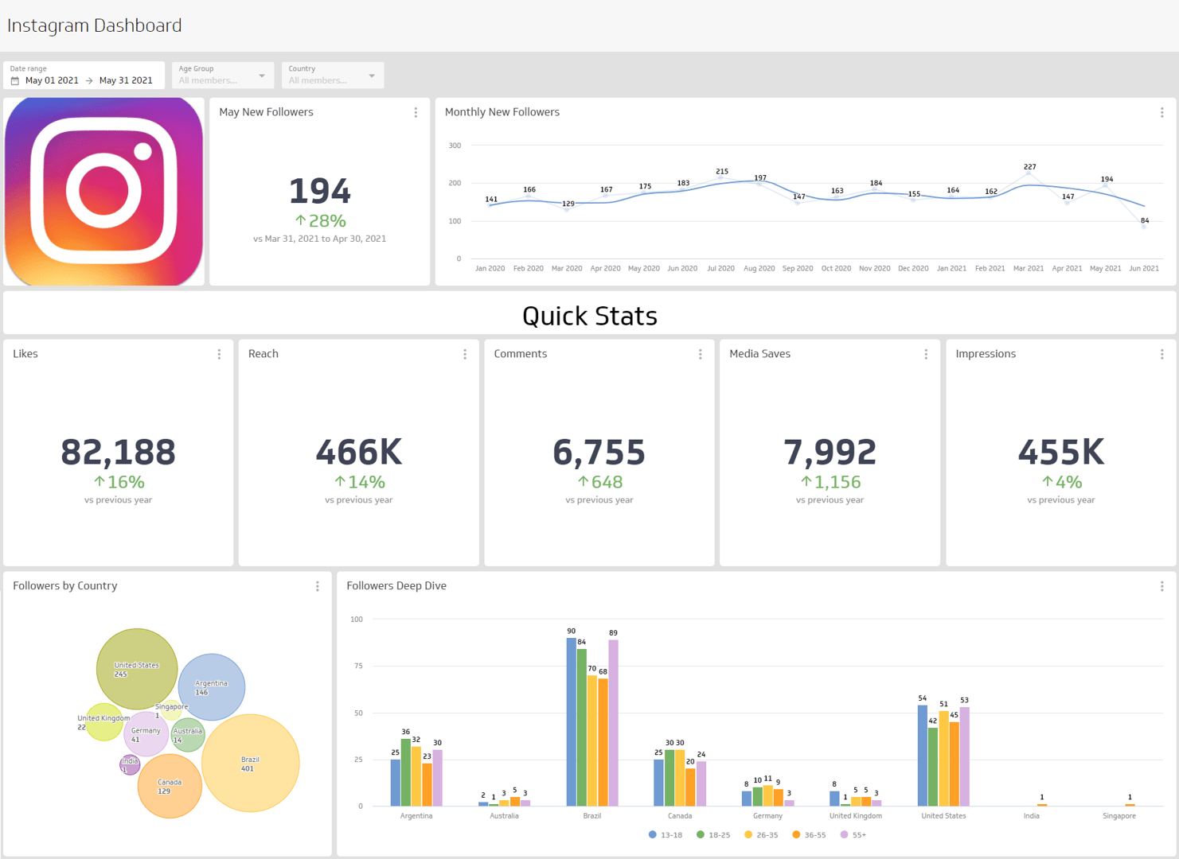

Slide 50
6. Organizational Change Management

Slide 51
4 6. Organizational Change Management
To ensure organizational changes are smoothly implemented and deliver lasting benefits by managing the human aspects.
Activity: 📌 Quick poll: “What makes people resist change the most? Fear? Workload? Confusion?”

Slide 52
4 6. Why Change Management?
Change affects roles, behaviour, work methods
People are the biggest factor in success
Without people’s support → even good changes fail
Mini-game: ❓ True/False: “Technology changes fail mainly due to technical issues.”

Slide 53
4 6. What OCM Achieves
Organizational Change Management helps:
Reduce resistance
Address impacts
Provide training & communication
Ensure successful adoption

Slide 54
4 6. Essential Elements of Successful Change
1️⃣ Clear & relevant objectives 2️⃣ Strong & committed leadership 3️⃣ Willing & prepared participants 4️⃣ Sustained improvement

Slide 55
4 6. A. Clear & Relevant Objectives
People support change when goals make sense
Objectives must provide real value
Must be communicated in context
Activity: ✍️ Micro-task: Write 1 example of a “bad change objective”.

Slide 56
4 6. B. Strong & Committed Leadership
Sponsors advocate and authorize the change
Leaders must be visible and consistent
Communication from leaders builds trust
Activity: 🎯 Identify: “Who is a sponsor? Who is a leader?”

Slide 57
4 6. C. Willing & Prepared Participants
People must believe the change matters
Training + awareness improves readiness
Frequent communication = lower fear
Activity: 🗣️ Role-play: “Trainer convincing a team about upcoming change.”

Slide 58
4 6. D. Sustained Improvement
Avoid “reverting to old habits”
Reinforce with: ✔ Communication ✔ Metrics ✔ Leader support ✔ Addressing impacts
Quick Quiz: “What happens if reinforcement is missing?”

Slide 59
4 6. Key OCM Activities
Activity | Helps Deliver
Sense of urgency | Clear objectives, willing participants
Stakeholder management | Strong participants
Sponsor management | Strong leadership
Communication | Prepared participants
Empowerment | Prepared participants
Resistance management | Willing participants
Reinforcement | Sustained improvement

Slide 60
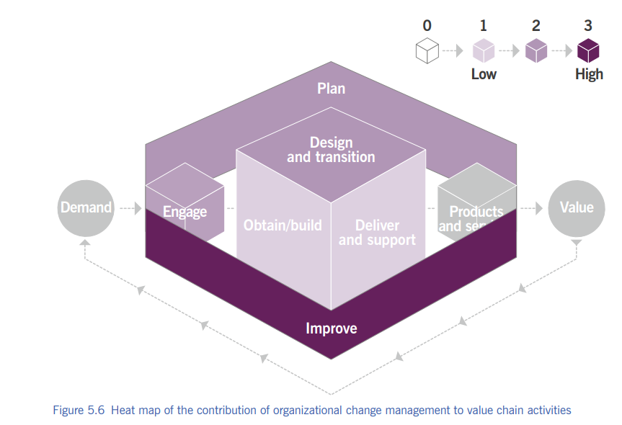

Slide 61
4 6. 🎮 “Change Resistance Bingo”
The school is switching to a new grading system.
We are introducing a new group project format.
The lunch menu is changing (e.g., healthier options only).
The dress code is being updated (e.g., stricter or more relaxed rules).
A new mandatory after-school program is being implemented.
The classroom seating arrangement will be flexible/chosen by students.
Students will be required to use a specific new software program for all assignments.

Slide 62
4 6. 🎮 “Change Resistance Bingo”
Learners mark boxes with common resistance lines like:
"This will never work."
"Why should we change?"
"We always did it this way."
"No one else is doing this."
"It's too complicated/hard."
"That's a stupid idea."
"It's going to be a lot more work."
"They didn't ask for our input."
"The old way was fine."
"I don't have enough time for this."
"This is just a fanny phase; it will pass

Slide 63
4 6. Mini Case Study
“College introduces a new attendance system → students, teachers, admin impacted.” Ask:
Who are stakeholders?
What training is needed?
How to reduce resistance?

Slide 64
7. Portfolio Management

Slide 65
4 7. Portfolio Management
Choosing the right work, at the right time, with the right resources.
Portfolio management = 📂 Deciding WHAT to do ⏳ WHEN to do it 💰 With HOW MUCH money & people
Real-life example: College deciding:
New course ❓
New lab ❓
Website upgrade ❓ (Not all at once!)
Icebreaker: 💬 Ask: “Can an organization do EVERYTHING at once?”

Slide 66
4 7. Portfolio vs Project
Portfolio | Project
Big picture | One task
Strategic | Operational
Long-term | Short-term

Slide 67
4 7. Portfolio vs Project (Mini Game)
Building a single mobile app to track fitness goals. →
Managing all software products for a company like Google. →
Creating a website for a local bakery. →
Overseeing a company’s entire investment in various energy sources (solar, wind, oil). → Writing a single report on market trends for the next quarter. →
Managing a country's total defense initiatives. →
Organizing an annual school carnival. →
Developing a multi-year plan for a city's public transportation system. →
Painting a single room in a house. →
Managing a real estate firm’s entire list of properties and developments. →

Slide 68
4 7. Why Portfolio Management is Needed
Without portfolio management:
Too many changes
Resource conflicts
Low-value projects survive
Strategy fails
Quick Question: ❓ “Is doing more work always good?”

Slide 69
4 7. What Portfolio Management DOES
Portfolio management:
Balances change vs business-as-usual
Aligns work with strategy
Controls investment & risk
Activity: ⚖️ Ask them to balance: “New system vs maintaining old one”

Slide 70
4 7. Activity 1: Evaluation & Prioritization
📋 Mini-Case
3 Projects, budget for only 1
Project | Value | Cost | Strategic Fit
A | High | Medium | Strong
B | Medium | Low | Weak
C | Very High | High | Strong

Slide 71
4 7. Activity 2: Linking to Outcomes
🎮 Game: Match the Following
Item | Correct Match
Service | Long-term strategic benefit
Product | Achieving a business goal
Project | Revenue generation
Programme | Customer satisfaction / Availability

Slide 72
4 7. Activity 3: Portfolio Reviews
❓ Question
“What should be reviewed FIRST?
Options:
Value
Strategic fit
Benefits
Risks
Costs
Progress

Slide 73
4 7. Types of Portfolios (Overview)
Portfolio management includes:
1️⃣ Product/Service Portfolio 2️⃣ Project Portfolio 3️⃣ Customer Portfolio

Slide 74
4 7. Product/Service Portfolio
Includes:
All current services
New services
Improvements
Third-party services
Represents:
Commitments
Investments
Example: College offerings: Degree, Certificate, Online courses

Slide 75
4 7. Project Portfolio
Used to:
Manage authorized projects
Avoid duplication
Control scope, cost, time
Manage programs (multiple projects)
Game: 🧩 Identify: Single project or programme?

Slide 76
4 7. Customer Portfolio
Maintained by:
Relationship management
Records:
All customers
Internal & external
Used to:
Understand customer outcomes
Validate value with customers
Activity: 👥 List internal vs external customers of your college

Slide 77
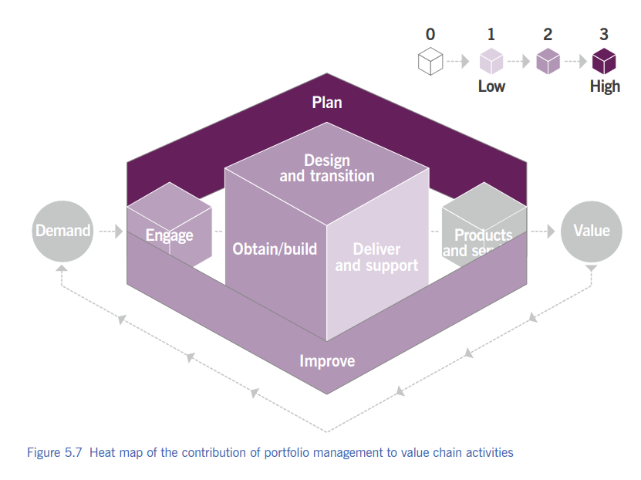

Slide 78
4 7. Exit Activity
🏁 Exit Activity (With Options)
✍️ Complete the sentence by choosing ONE option:
“Portfolio management is important because…”
A️⃣ it aligns work with business strategy B️⃣ it helps use resources efficiently C️⃣ it ensures focus on value delivery D️⃣ it avoids random decision-making E️⃣ All of the above

Slide 79
8. Project Management Turning plans into results

Slide 80
4 8. Project Management
Project management means:
Planning the work
Assigning people
Tracking progress
Fixing problems
Keeping people motivated
Real-life example: 🎉 College fest planning
👉 Project management = making sure the project ACTUALLY finishes

Slide 81
4 8. What is a Project?
A project is:
Temporary
Has a clear goal
Delivers one or more outputs
Based on a business case
Ask students: ❓ “Is daily teaching a project?” (NO – business as usual)

Slide 82
4 8. Why Project Management is Important
Organizations must balance: 1️⃣ Running current operations 2️⃣ Transforming to survive 3️⃣ Continually improving services

Slide 83
4 8. Project vs Business as Usual (Game)
Project | Business as Usual
Temporary | Ongoing
Has end date | No end date
Change-focused | Stability-focused

Slide 84
4 8. Standalone Project or Programme
Projects can be:
Standalone
Part of a programme (many related projects)
Example: 📱 App development programme:
UI project
Backend project
Testing project

Slide 85
4 8. Project & Project Portfolio
Even single projects:
Must align with project portfolio
Must match organizational strategy
Question: ❓ “Should useless projects be allowed?”

Slide 86
4 8. Risk of Poor Project Management
Without proper management:
Resource conflicts
Service disruption
Customer dissatisfaction
Employee burnout
Quick discussion: 😵 “What happens if everyone works on projects AND daily work?”

Slide 87
4 8. Role of People in Projects
Projects depend on:
Right people
Right skills
Right time
Even best plan fails if: ❌ People are missing ❌ No cooperation

Slide 88
4 8. Project Team Reality
Project team members:
Often come from daily operations
Work full-time or part-time
Must balance both roles
Relatable example: 👩‍🏫 Teacher + committee work

Slide 89
4 8. Project Delivery Approaches
Two common methods: 1️⃣ Waterfall 2️⃣ Agile
Waterfall | Agile
Fixed plan | Flexible
Slow changes | Fast changes
Heavy documentation | Working output

Slide 90
4 8. Value Chain: Design & Transition AND Obtain / Build
New service design = project
Major changes = project
Example: 🖥️ New ERP system rollout
Resource acquisition
Development
Integration
All managed as projects
Ask: ❓ “Can development happen without planning?”

Slide 91
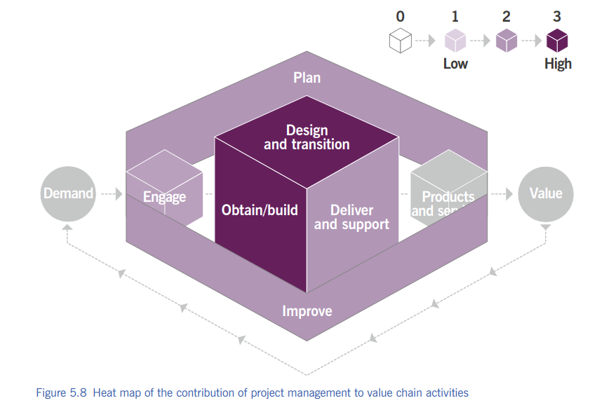

Slide 92
4 8. Summary Slide
✅ Ensures projects succeed ✅ Manages change safely ✅ Balances projects & operations ✅ Supports all value chain activities ✅ People are the key factor

Slide 93
9. Relationship Management Because services are built on relationships

Slide 94
4 9. Relationship Management
Relationship management means:
Understanding people’s needs
Talking to them regularly
Solving conflicts
Keeping everyone satisfied
👉 Good services come from good relationships

Slide 95
4 9. Who Are Stakeholders?
Stakeholders include:
Customers
Users
Sponsors
Employees
Suppliers
Partners
🎮 Activity: Ask students: ❓ “Who are the stakeholders in our college?”

Slide 96
4 9. What Relationship Management Does
This practice ensures that:
✔ Stakeholder needs are understood ✔ Right products/services are prioritized ✔ Customer satisfaction stays high ✔ Trust is built and maintained

Slide 97
4 9. Customer Priorities
Relationship management helps:
Identify customer priorities
Align them with business outcomes
Clearly communicate requirements
Example: 🎓 Students want faster exam results → IT system upgrade

Slide 98
4 9. Handling Complaints & Escalations
Ensures complaints are:
Handled sympathetically
Follow a formal process
Resolved professionally
Key exam phrase: 👉 “Sympathetic yet formal process”

Slide 99
4 9. Value Creation Through Relationships
Relationship management ensures:
Services create value for customers
Services also benefit the organization
Win–win outcomes
🧠 Think: ❓ Can value be created if relationships are bad?

Slide 100
4 9. Managing Conflicting Needs
Example:
Students want flexible deadlines
Management wants strict rules
Relationship management: ✔ Mediates conflicts ✔ Finds balance

Slide 101
4 9. Not Only Customers!
Organizations must manage:
Internal stakeholders
External stakeholders
Not just service consumers!
Key reminder: 👉 Ignoring internal stakeholders = service failure

Slide 102
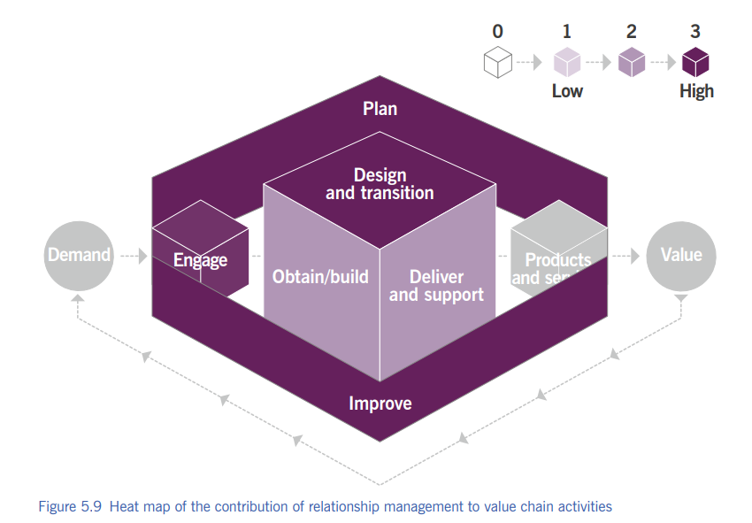

Slide 103
4 9. Summary Slide
✅ Builds trust ✅ Manages stakeholders ✅ Handles conflicts ✅ Improves satisfaction ✅ Supports value creation

Slide 104
10. Risk Management “Is taking no risk also a risk?”

Slide 105
4 10. Risk Management
Risk management means:
Knowing what can go wrong
Knowing what can go right
Deciding what risk is worth taking
👉 Risk includes both threats and opportunities

Slide 106
4 10. Risk Is NOT Always Bad
⚠️ Threat risk:
System failure
Data loss
🌱 Opportunity risk:
Launching a new app
Entering a new market
❌ Avoiding opportunity = also a risk!

Slide 107
4 10. Portfolio & Risk
Every:
Product , Service and Project
Has associated risks.
✔ Good service management → opportunity ❌ Poor service management → threat
Example: New service = value opportunity + failure risk

Slide 108
4 10. Three Core Risk Activities
Are the benefits worth the risk?
Risk management requires:
1️⃣ Identify 2️⃣ Assess 3️⃣ Treat

Slide 109
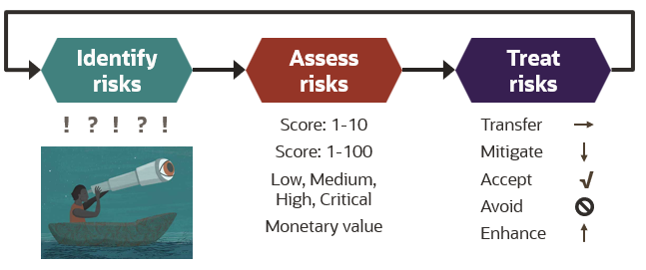

Slide 110
4 10. Risk Identification
✔ Identify uncertainties ✔ Describe them clearly ✔ Ensure common understanding
Example:
“Server may crash during peak usage”

Slide 111
4 10. Risk Assessment
Assess:
Probability (How likely?)
Impact (How serious?)
Proximity (How soon?)
🎯 Result: Risk exposure

Slide 112
4 10. Risk Treatment
Decide what to do:
Avoid
Reduce
Share
Accept
Assign: ✔ Owners ✔ Actions ✔ Monitoring

Slide 113
4 10. Principle: Risk Is Part of Business
✔ Risk cannot be eliminated ✔ Risk-taking is necessary ✔ Must align with risk appetite
🧠 Risk appetite = how much risk an organization is willing to take

Slide 115
4 10. Good Risk Behaviour Includes
Risk management depends on people behavior.
✔ Reporting incidents ✔ Reporting opportunities ✔ Clear roles & responsibilities ✔ Fair reward systems

Slide 116
4 10. ISO 31000 Connection
ISO 31000 says:
“Risk management creates and protects value”
Benefits:
Improves performance
Encourages innovation
Supports objectives

Slide 117
4 10. Classroom Activity: “Risk Spotter” ⚠️
Give scenario:
College online exam system
Ask students to list:
2 threats
1 opportunity
1 risk treatment

Slide 118
4 10. Exam Memory Box
🧠 Remember:
Threat + Opportunity
Identify–Assess–Treat
Risk appetite
Risk culture
ISO 31000

Slide 119
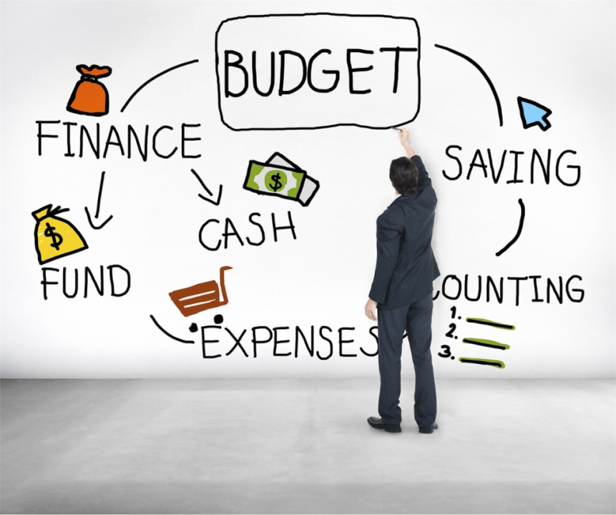
11. Service Financial Management 💰 Managing money for services

Slide 120
4 11. Service financial management
Service financial management answers:
Where should we spend money?
How much does a service cost?
Are we getting value for money?
💡 Right service + right cost + right value
Supports organization’s strategies and plans

Slide 121
4 11. Finance = Common Language
Finance allows communication with:
Management
Customers
Suppliers
Investors
💬 Everyone understands money

Slide 122
4 11. Budgeting & Costing
Predicting and controlling income & expenditure
Includes:
Setting budgets
Monitoring spending
Forecasting service demand
🎓 College example: Department budget planning for labs

Slide 123
4 11. Service-Based Budgeting
Full cost of providing a service
Full cost of consuming a service
🧠 Not just “IT cost” → “Cost per service”

Slide 124
4 11. Accounting
Track how money is actually spent
Includes:
Forecast vs actual comparison
Cost per:
Customer
Service
Activity
Uses: ✔ Ledgers ✔ Journals ✔ Charts of accounts

Slide 125
4 11. Charging
Billing customers for services used
✔ Mostly for external customers ✔ Charging is optional ❌ Funding is NOT optional
🧠 All services must be funded somehow

Slide 126
4 11. Classroom Activity: “Who Pays?” 💸
Give examples:
College Wi-Fi
Netflix
Cloud storage
Ask: ✔ Who pays? ✔ Fixed or usage-based?

Slide 127
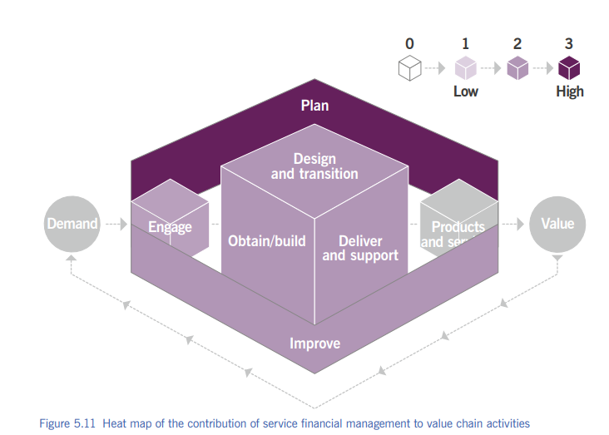

Slide 128
4 11. Value Chain: Plan
Supports planning with:
Budgets
Forecasts
Financial reports
📌 No plan works without money

Slide 129
4 11. IT Budgets: Old vs New
Traditional IT:
CAPEX (one-time purchase)
Fixed budgets
Modern IT (Cloud):
OPEX (subscription)
Pay-as-you-use
🧠 Example: Buying server vs AWS subscription

Slide 130
4 11. CAPEX vs OPEX
CAPEX | OPEX
One-time | Ongoing
Fixed | Variable
Hardware | Subscription

Slide 131
4 11. Procurement Challenges
Cloud services:
Variable pricing
Usage-based payment
Organizations must: ✔ Update procurement rules ✔ Train staff
Otherwise → barrier to digital services

Slide 132
4 11. Exam Memory Box 🧠
Remember: ✔ Budgeting, Accounting, Charging ✔ CAPEX vs OPEX ✔ ROI ✔ Funding vs Charging ✔ Finance supports SVS

Slide 133

Thank you…

